Slide 2
Chittamwood

Slide 4
Texas Wintergrass

Slide 5
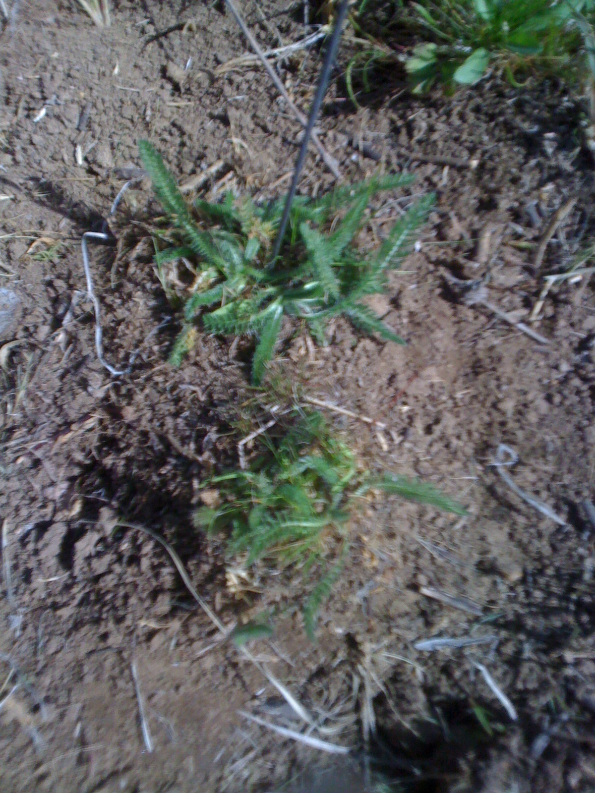

Slide 6
Yarrow

Slide 7
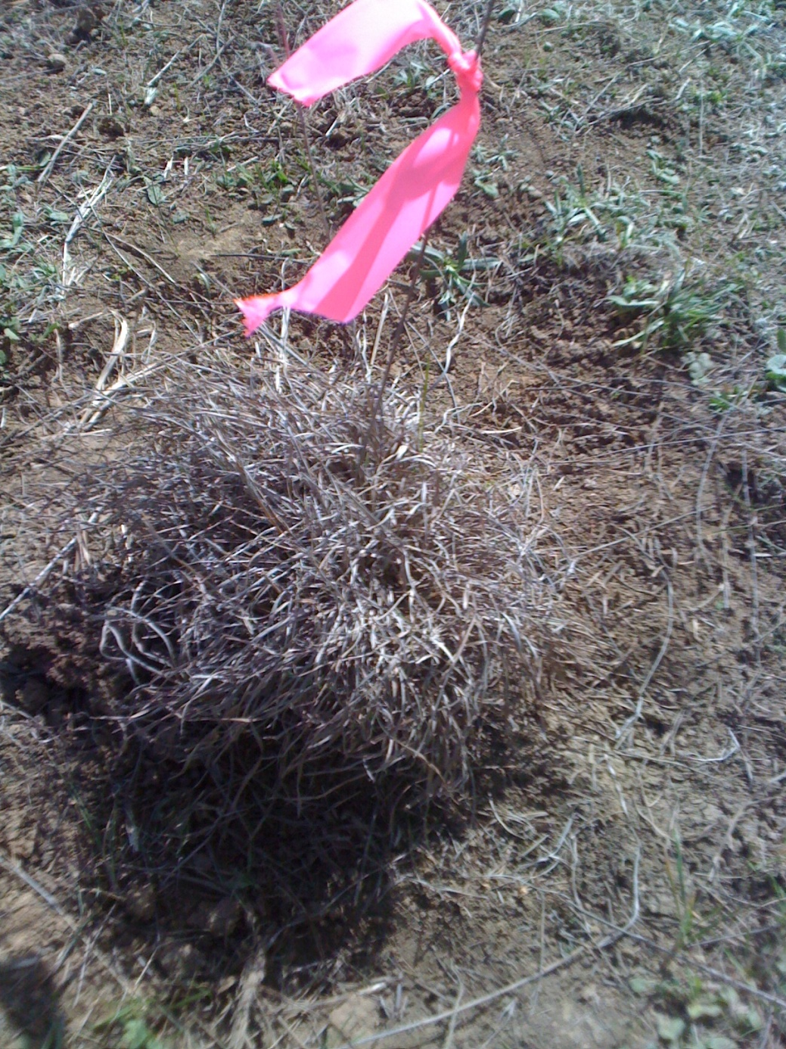

Slide 8
Little Bluestem

Slide 10
Annual Brome

Slide 12
Mesquite

Slide 14
Sagewort

Slide 15
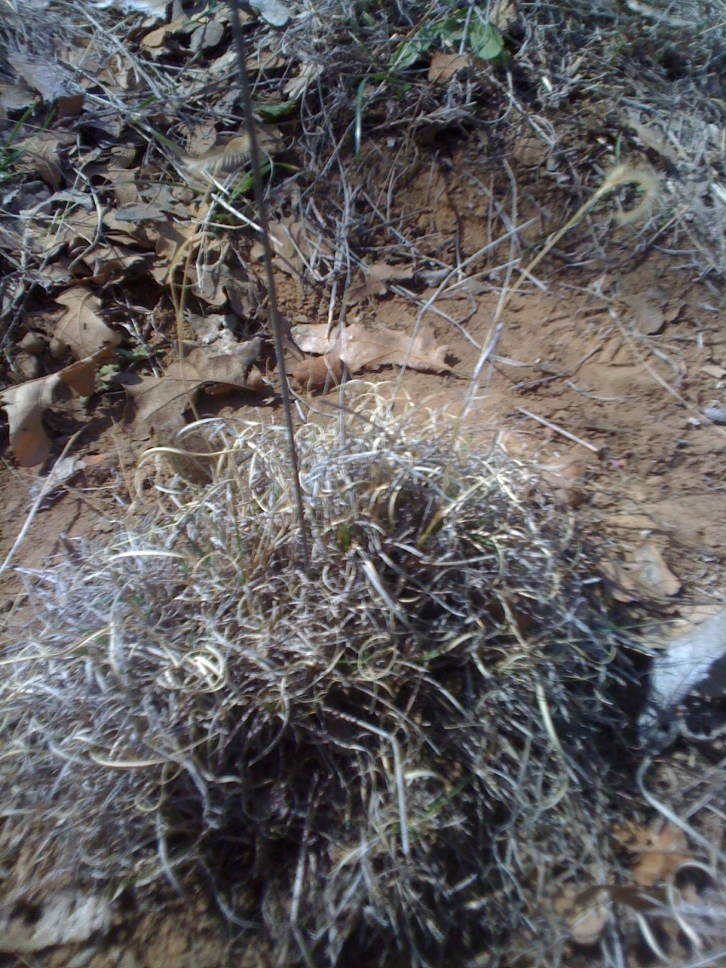

Slide 16
Blue Grama

Slide 18
Western Ragweed

Slide 20
Perennial Dropseed

Slide 22
Tumble Grass

Slide 24
Prairie Coneflower/ Mexican Hat

Slide 26
Sideoats Grama

Slide 28
Dotted Gayfeather

Slide 30
Perennial Threeawn

Slide 32
Engelmann Daisy

Slide 34
Western Ragweed

Slide 36
Wildrye

Slide 38
Sedge

Slide 40
Silver Bluestem

Slide 42
Halfshrub Sundrop

Slide 44
Common Broomweed

Slide 46
Elm

Slide 48
Wax Goldenweed

Slide 50
Curlycup Gumweed

Slide 51
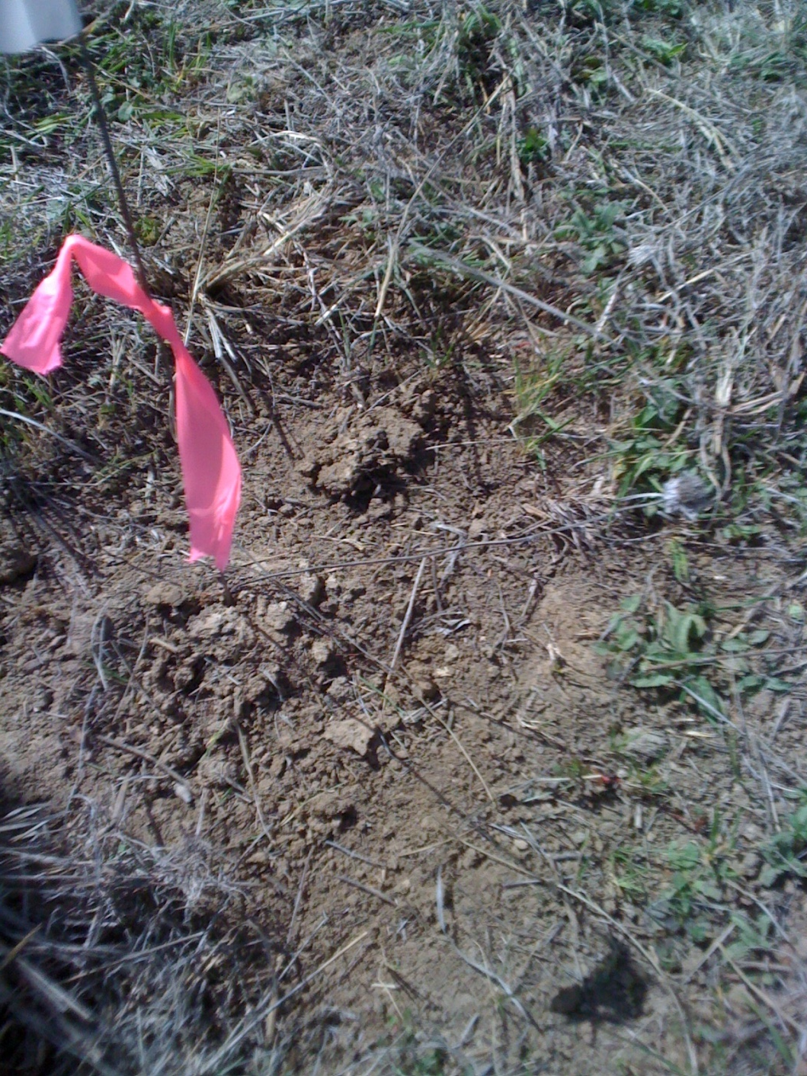

Slide 52
Beebalm

Slide 54
Plains Yucca

