Slide 1
Cat Breeds
PEER Program, Texas A&M University

Slide 2
Abyssinian

Slide 3
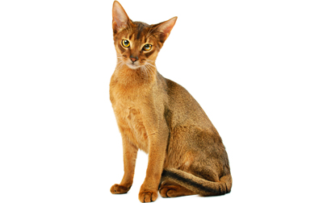
Abyssinian
One of the oldest known breeds, history is controversial
Name comes from the fact that first cats of this breed shown in England were reported to have been imported from Abyssinia (now Ethiopia)
First Abyssinians imported to North America from England in the early 1900s
A very people-oriented cat

Slide 4
Abyssinian
Colorful cat with distinctly ticked coat, medium size. Lithe, hard and muscular, well-balanced
View this link to learn more about Abyssinian cats
http://www.cfa.org/Portals/0/documents/breeds/standards/abyssinian.pdf

Slide 5
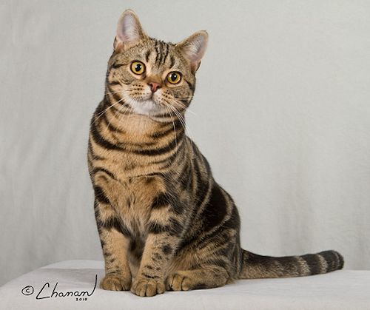
American Shorthair

Slide 6
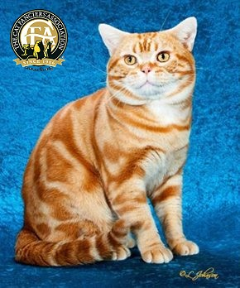
American Shorthair
Known for its longevity, robust health, good looks, sweet personality, and amiability
Originated from cats following settlers from Europe to North America
Bred selectively to preserve the working cat’s structure
Renamed “American Shorthair in 1966

Slide 7
American Shorthair
True breed of working cat, no part of anatomy should foster weakness. Strongly built, well balanced, symmetrical cat.
Visit this link to see many variations in American Shorthair colors:
http://www.cfa.org/Portals/0/documents/breeds/standards/american-sh.pdf

Slide 8
Burmese

Slide 9
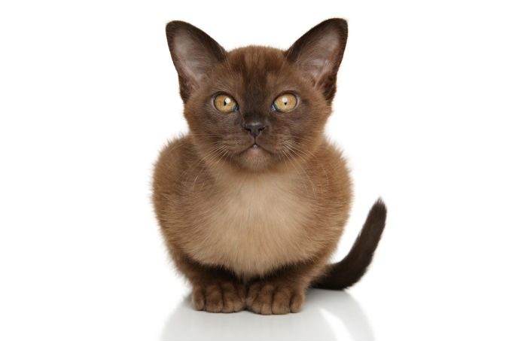
Burmese
Brought to America in 1930 by Dr. Joseph Thompson of San Francisco from Burma
Kittens of this breed can be quite spirited, remain playful into adulthood
Desire human attention
Outgoing and fearless, and therefore should not be allowed outside

Slide 10
Burmese
The ideal Burmese would be a cat of medium size with substantial bone structure, good muscle development and a surprising weight for its size. This together with a rounded head, expressive eyes and a sweet expression makes a Burmese.
Visit this link to read more about Burmese Coloring
http://www.cfa.org/Portals/0/documents/breeds/standards/burmese.pdf

Slide 11
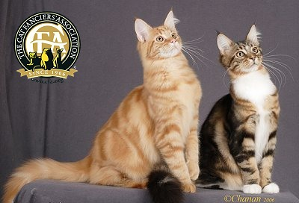
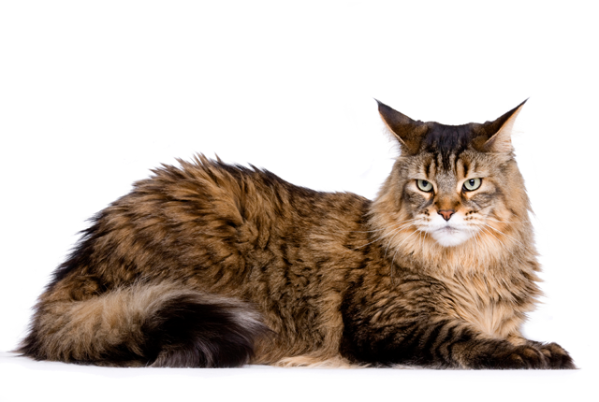
Maine Coon

Slide 12
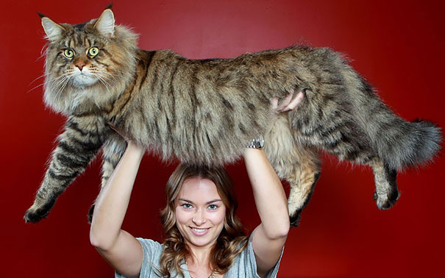
Maine Coon
The native American long-haired cat, first recognized as a specific breed in Maine
Developed through “survival of the fittest” evolution
All characteristics have a purpose or function
Sturdy, working cats suited for harsh winters
Intelligent, trainable, “dog like”
About 75 different color combinations

Slide 13
Maine Coon
Originally a working cat, should be solid and rugged. The most distinctive characteristic should be its smooth, shaggy coat. Should be well proportioned and balanced.
Visit this link to read more about characteristics
http://www.cfa.org/Portals/0/documents/breeds/standards/maine.pdf

Slide 14
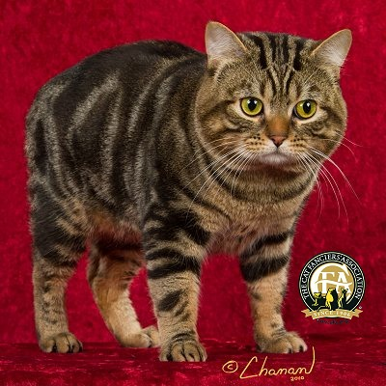
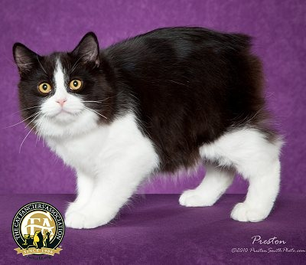
Manx

Slide 15
Manx
Working cat, originated on the Isle of Man in the Irish Sea
Taillessness caused by a mutation, although does have a gene for a full tail; can have all tail length
Only those with no tail at all are eligible for competition in CFA (called rumpy)
Longhaired or shorthaired, both are “double coats”, so should be dense and plush
Also known for robust and rounded appearance with depth of flank

Slide 16
Manx
Overall impression should be of roundness—round head, round muzzle, round rump. Great depth of flank and rounded, muscular thighs. Surprisingly heavy when lifted.
Visit this link to learn more about Manx characteristics
http://www.cfa.org/Portals/0/documents/breeds/standards/manx.pdf

Slide 17
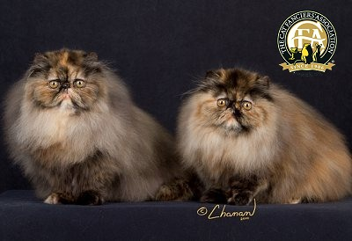
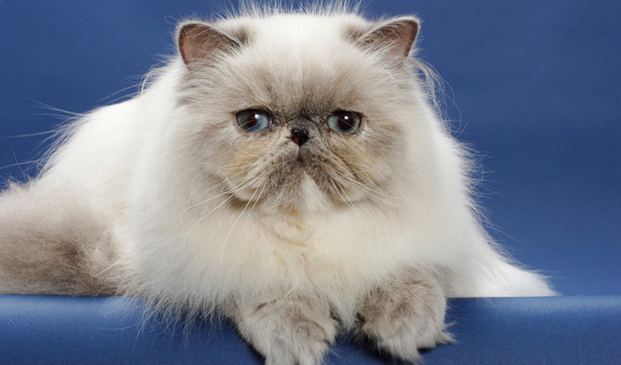
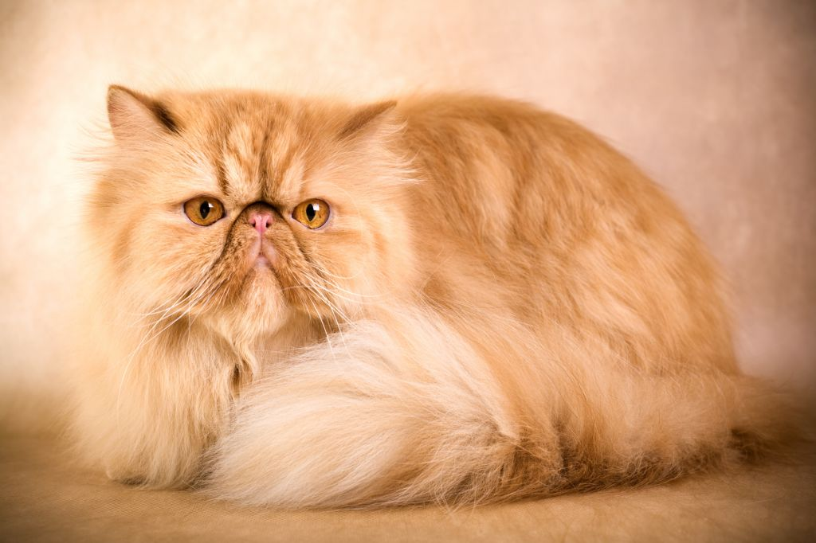
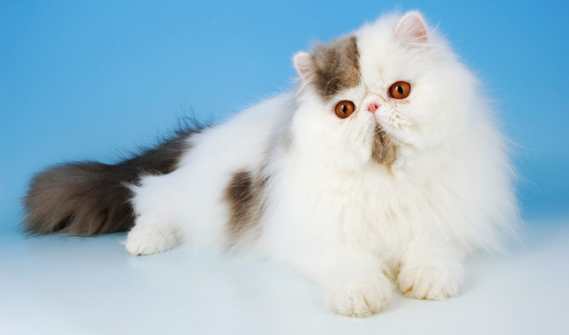
Persian

Slide 18
Persian
Called Persian for their country of origin, rode in caravans between Persia and Iran
Number one breed in popularity
Short, heavilyboned legs to support their short, broad bodies
Must be brushed daily with a metal comb
Come in many colors that are divided into seven color divisions

Slide 19
Persian
Should be heavily boned, well-balanced. Large, round eyes should be set wide apart in a large round head. Long, thick coat.
Visit this link to learn more about Persian characteristics
http://www.cfa.org/Portals/0/documents/breeds/standards/persian.pdf

Slide 20
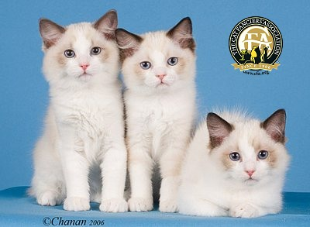
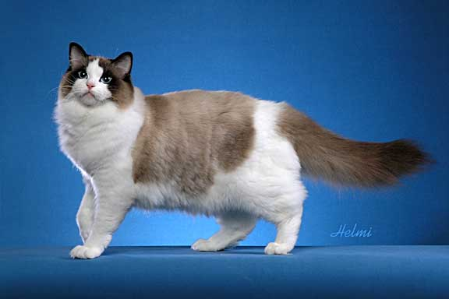
Ragdoll

Slide 21
Ragdoll
Pointed breed, meaning the body is lighter in color than the points (face, legs, tail, and ears)
Semi longhaired with blue eyes
Three patterns (two with white and one with no white), although a large number of color combinations possible
No extreme features
Developed by a breeder in California in the 1960s

Slide 22
Ragdoll
Medium to large cats with no extreme features. Blue-eyed and pointed.
Visit this link to learn more about Ragdoll Cats
http://www.cfa.org/Portals/0/documents/breeds/standards/ragdoll.pdf

Slide 23
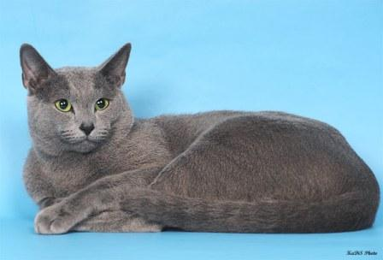
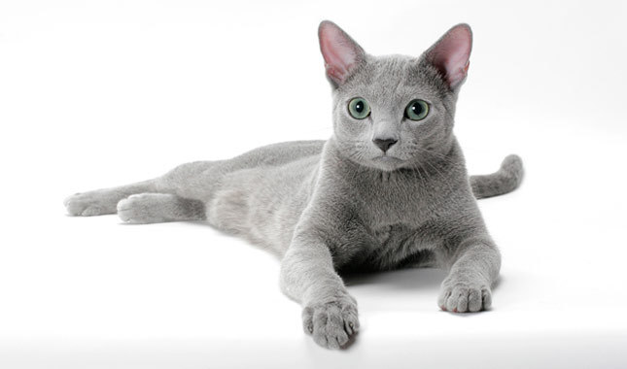
Russian Blue

Slide 24
Russian Blue
Shorthair breed with a silvery blue coat and green eyes
Minimal grooming required
Believed to have come from Russia, but origin is still unknown
One color – blue, one coat length - short

Slide 25
Russian Blue
Good physical condition, firm in muscle tone, blue coat with silvery appearance, short coat
Visit this link to learn more about the Russian Blue
http://www.cfa.org/Portals/0/documents/breeds/standards/russian.pdf

Slide 26
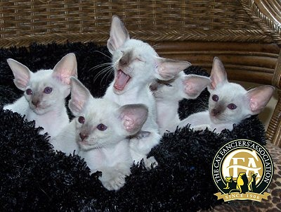
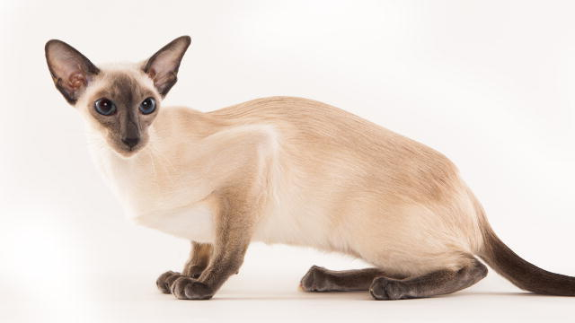
Siamese

Slide 27
Siamese
Exported from Thailand (then known as Siam) in the late 1800s
Came to United States as a gift to the President from the American Consul in Bangkok
Sleek lines, deep blue eyes, short silky coats
One of the original breeds of pedigreed cats

Slide 28
Siamese
Medium-sized, svelte, very lithe but muscular. Males may be proportionately larger. Balance and refinement are the essence of the breed.
Visit this link to learn more about Siamese cats
http://www.cfa.org/Portals/0/documents/breeds/standards/siamese.pdf

Slide 29
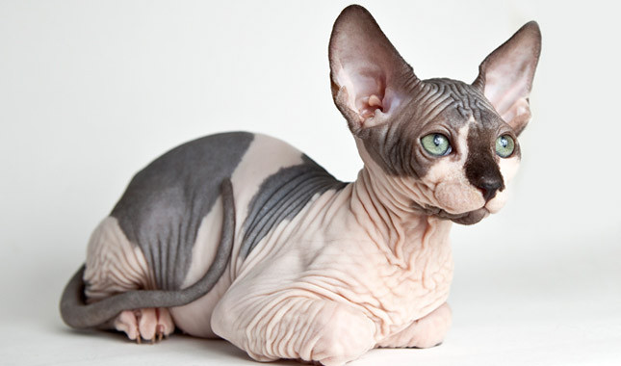
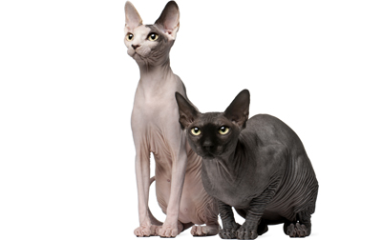
Sphynx

Slide 30
Sphynx
Came into existence why a hairless kitten was born in Canada; discovered to be a natural genetic mutation
Not always totally hairless, have varied degrees of “hairlessness”
All colors and patterns are possible and may be presented at any stage of maturity
Periodic bathing required

Slide 31
Sphynx
Most distinctive feature is that of hairlessness, although are not completely hairless (should be some evidence of “hair” on the bridge of the nose and the ears). Medium size.
View this link to learn more about Sphynx cats
http://www.cfa.org/Portals/0/documents/breeds/standards/sphynx.pdf

