Slide 1
Rabbits
PEER PROGRAM, TEXAS A&M UNIVERSITY

Slide 2
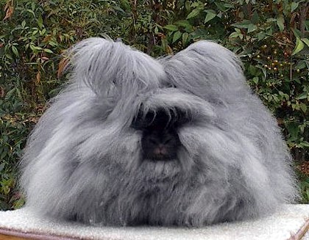
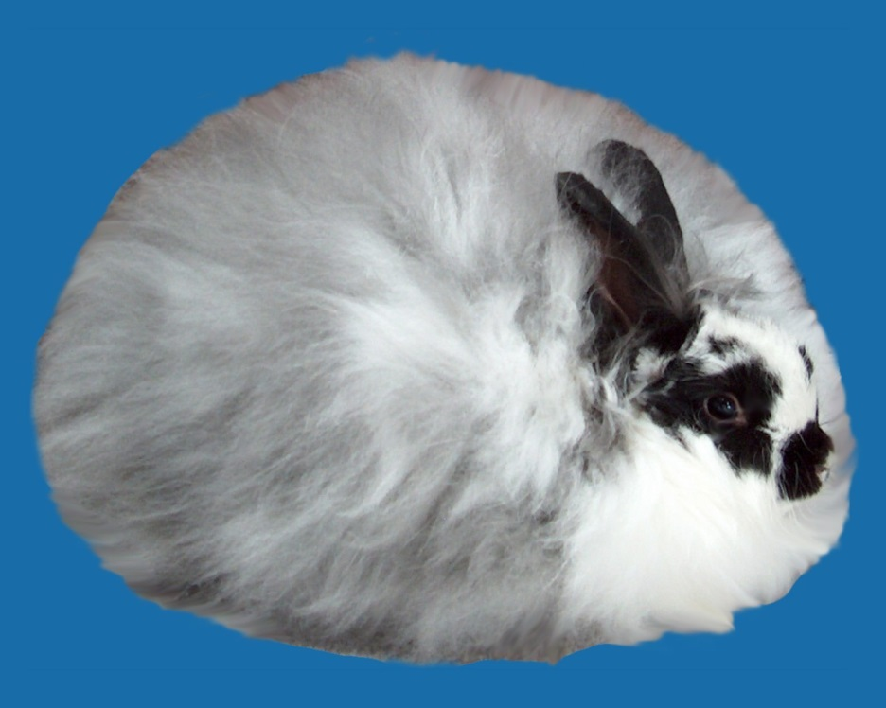
Angora
http://rabbitbreeders.us/rabbit-breeds
English Angora
Many recognized colors and white
5-7.5 pounds
Smallest Angora breed
Wool is more important feature
French Angora
Many recognized colors and white
9-10.5 pounds
Stands out because of lack of furnishings on the ears and face, relatively coarse wool

Slide 3
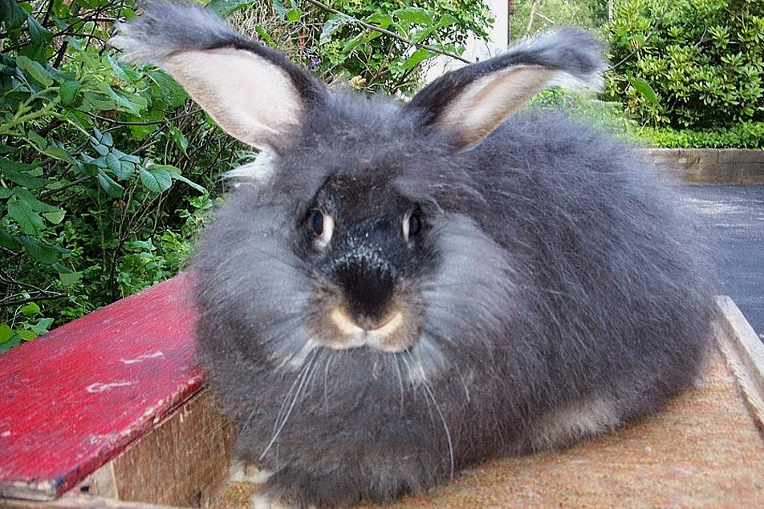
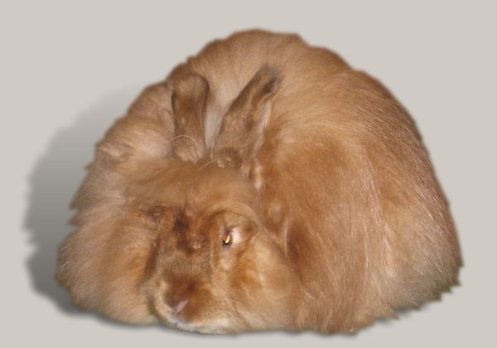
Angora
http://rabbitbreeders.us/rabbit-breeds
Giant Angora
Many colors and white recognized
Minimum of 9.5-10 pounds
Wool is extremely valuable
Satin Angora
Many colors and white recognized
Under 9.5 pounds
Satin coats distinguishes from other Angoras
Similar to French; smaller, does not recognize broken color patterns

Slide 4
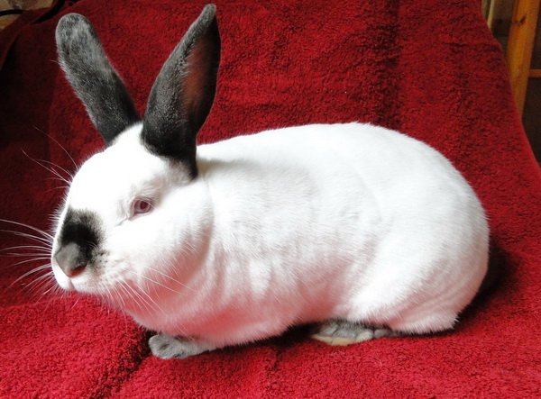
Californian
8-10.5 pounds
One step up from Albino; color is restricted to the points only (nose, ears, feet, and tail)
Eyes are ruby red
Color must be “as near as black as possible”
http://rabbitbreeders.us/californian-rabbits

Slide 5
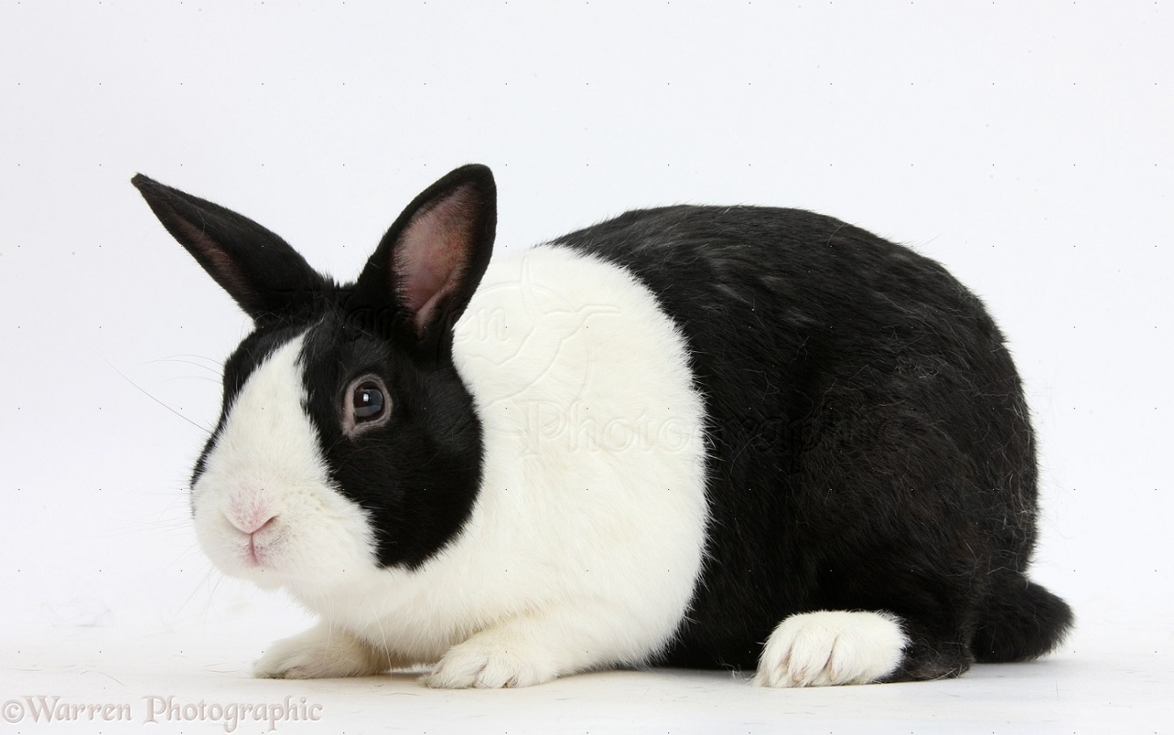
Dutch
Recognized as black, blue, chocolate, tortoise, steel, gray
4-5.5 pounds
Cheek markings should be round circles on either side of the head, dividing line of the body color should be an even belt encircling the rabbit’s middle
The front 1/3 of the body and hind feet should be white
http://rabbitbreeders.us/dutch-rabbits

Slide 6
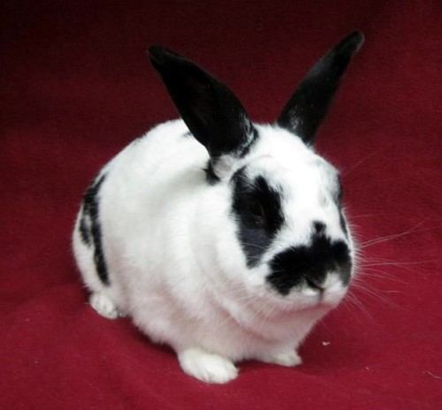
English Spot
Recognized as black, blue, chocolate, lilac, tortoise, gray, gold
5-8 pounds
Have colored ears, a “butterfly-shaped” nose marking, spots on the shoulder
Spots on shoulder should be an unbroken chain trailing from the top of the shoulder, across the flank and spreading out at the hip
Spots should be as round as possible, size should increase as they travel down the rabbit’s side
http://rabbitbreeders.us/english-spot-rabbits

Slide 7
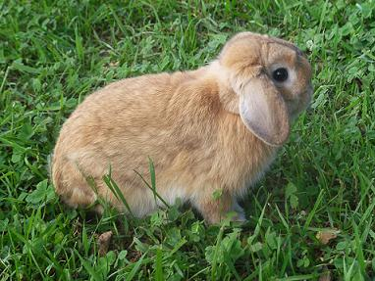
Holland Lop
Shown in two groups: broken and solid
Not over 4 pounds
“Tortoise” colored remains the most popular
Supposed to have a massive look but be a small bunny
Ears should be short, thick, and round in shape
Body should be short and muscular
http://rabbitbreeders.us/holland-lop-rabbits

Slide 8
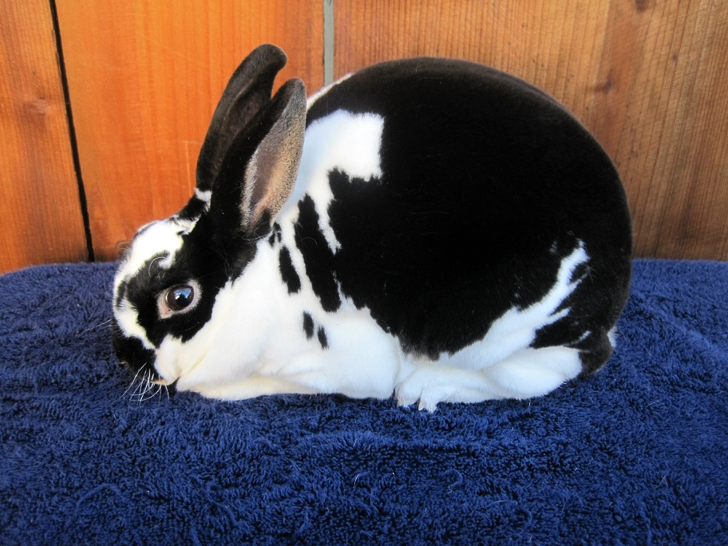
Mini-Rex
Recognized colors: many recognized colors, refer to link below
3-4.5 pounds
Have a distinctive fur type caused by a recessive gene
Carries a dwarf gene, but is not extreme
Fur sticks up nearly perpendicular to body
Most popular colors are black, broken, and castor
http://rabbitbreeders.us/mini-rex-rabbits

Slide 9
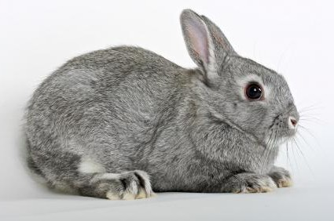
Netherland Dwarf
Many recognized colors
2-2.5 pounds
Often compared to the Holland Lop
Broad, medium-heavyset with short ears and bodies
Should be round in all aspects
http://rabbitbreeders.us/netherland-dwarf-rabbits

Slide 10
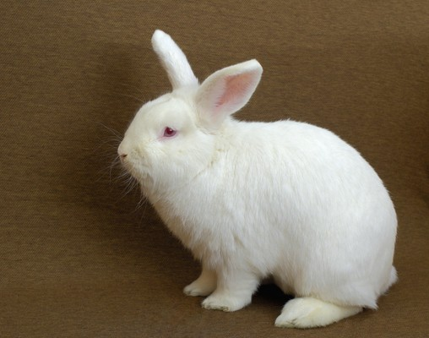
New Zealand
Recognized as black, broken, red, white
9-12 pounds
Used in meat production more than any other breed
Balance is key, ears should balance in length with head and body
White is the most valuable for commercial purposes, so is most commonly seen
http://rabbitbreeders.us/new-zealand-rabbits

